Slide 1
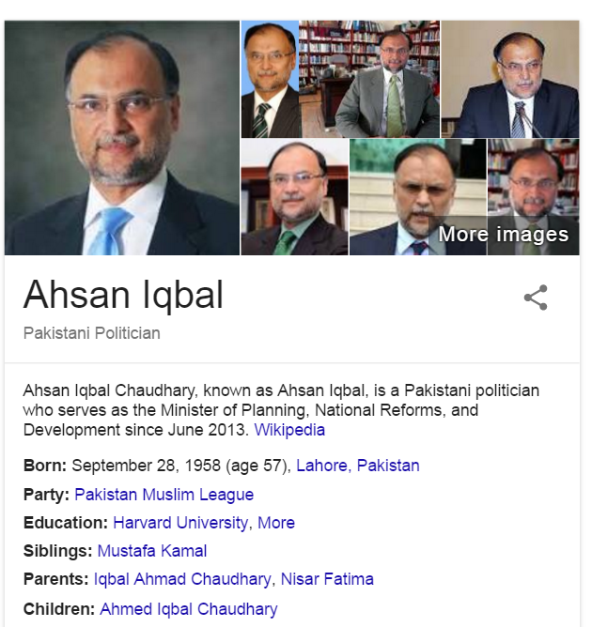
احسن اقبال چودھری‎

Slide 2
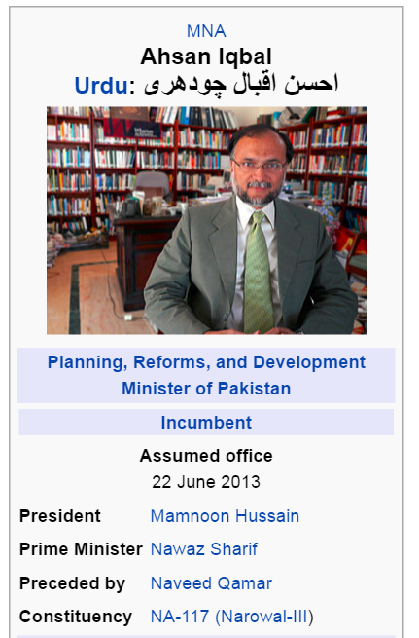
Ahsan Iqbal Chaudhary (Urdu: احسن اقبال چودھری; b 28 September 1958), known as Ahsan Iqbal, is a Pakistani politician who serves as the Minister of Planning, National Reforms, and Development since June 2013.[1] He also serves as the Member of Parliament of Pakistan representing the mainly rural district of Narowal. He is a prominent leader of Pakistan Muslim League and serves as its Deputy Secretary General and member of its Central Executive Committee.[2]

Slide 3
